Slide 1
Data Visualization Challange
Sophia Hoeller

Slide 2
GOAL
Understand user behavior on websites across Italy
Analyze web activity by region, province, device, OS, and browser
Identify the most visited websites and active users
Compare KPIs across geographic and technical segments.

Slide 3
WORKFLOW
Data loading & merging (Colab)
Cleaning & filtering
Exploratory Data Analysis (EDA)
Visualizations in Python
Interactive dashboards in Tableau

Slide 4
DATA CLEANING HIGHLIGHTS
Missing Values Detection
Missing values filled for categorical variables
Mapped numeric codes to real names
Removed users with no website activity
Detected outliers using IQR method:
Cookie lifespan → no outliers
Activity duration → 133 outliers
Total activity → 315 “power users”
! Outliers analyzed but not removed

Slide 5
EXPLORATORY DATA ANALYSIS (EDA)
The most relevant variables were explored through graphical correlation and comparative analysis.
Main KPIs Explored:
Total user activity (attivita_totali);
Cookie lifetime (durata_vita);
Most visited websites;
Top users, regions, and provinces.

Slide 6
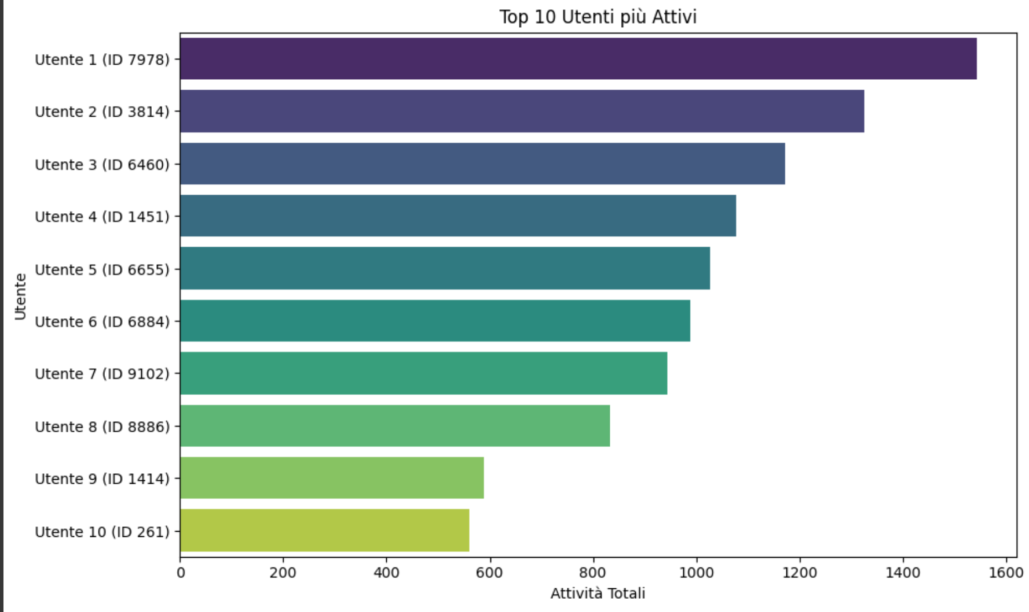
EDA-THE 10 MOST ACTIVE USERS

Slide 7
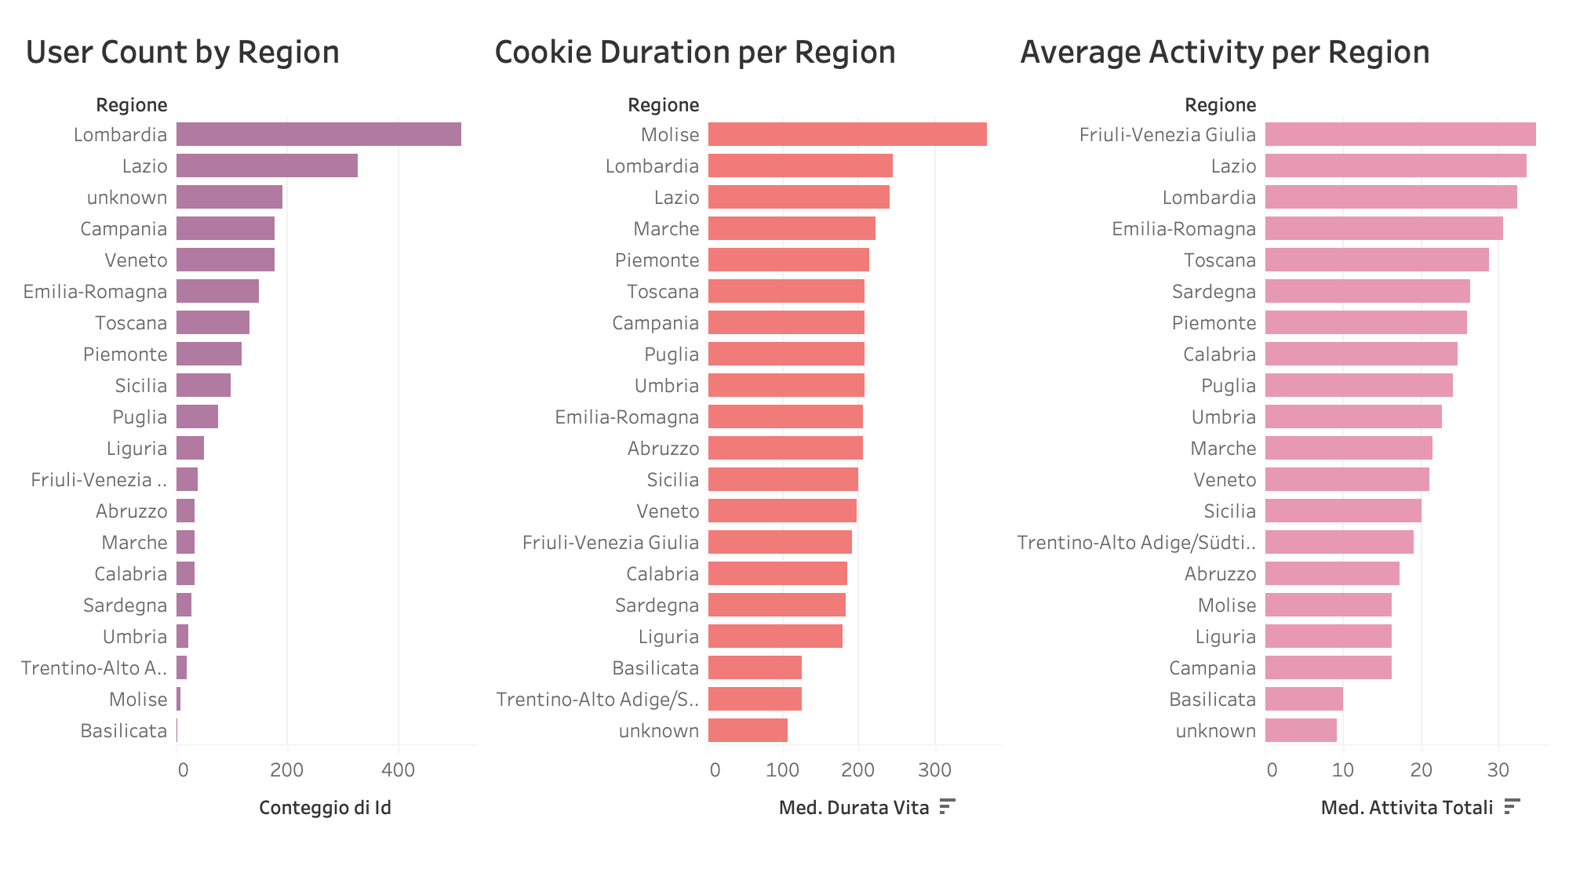
EDA- Regional Engagement
Graphical Analysis:
User count by region;
Average activity per region
Average cookie duration

Slide 8
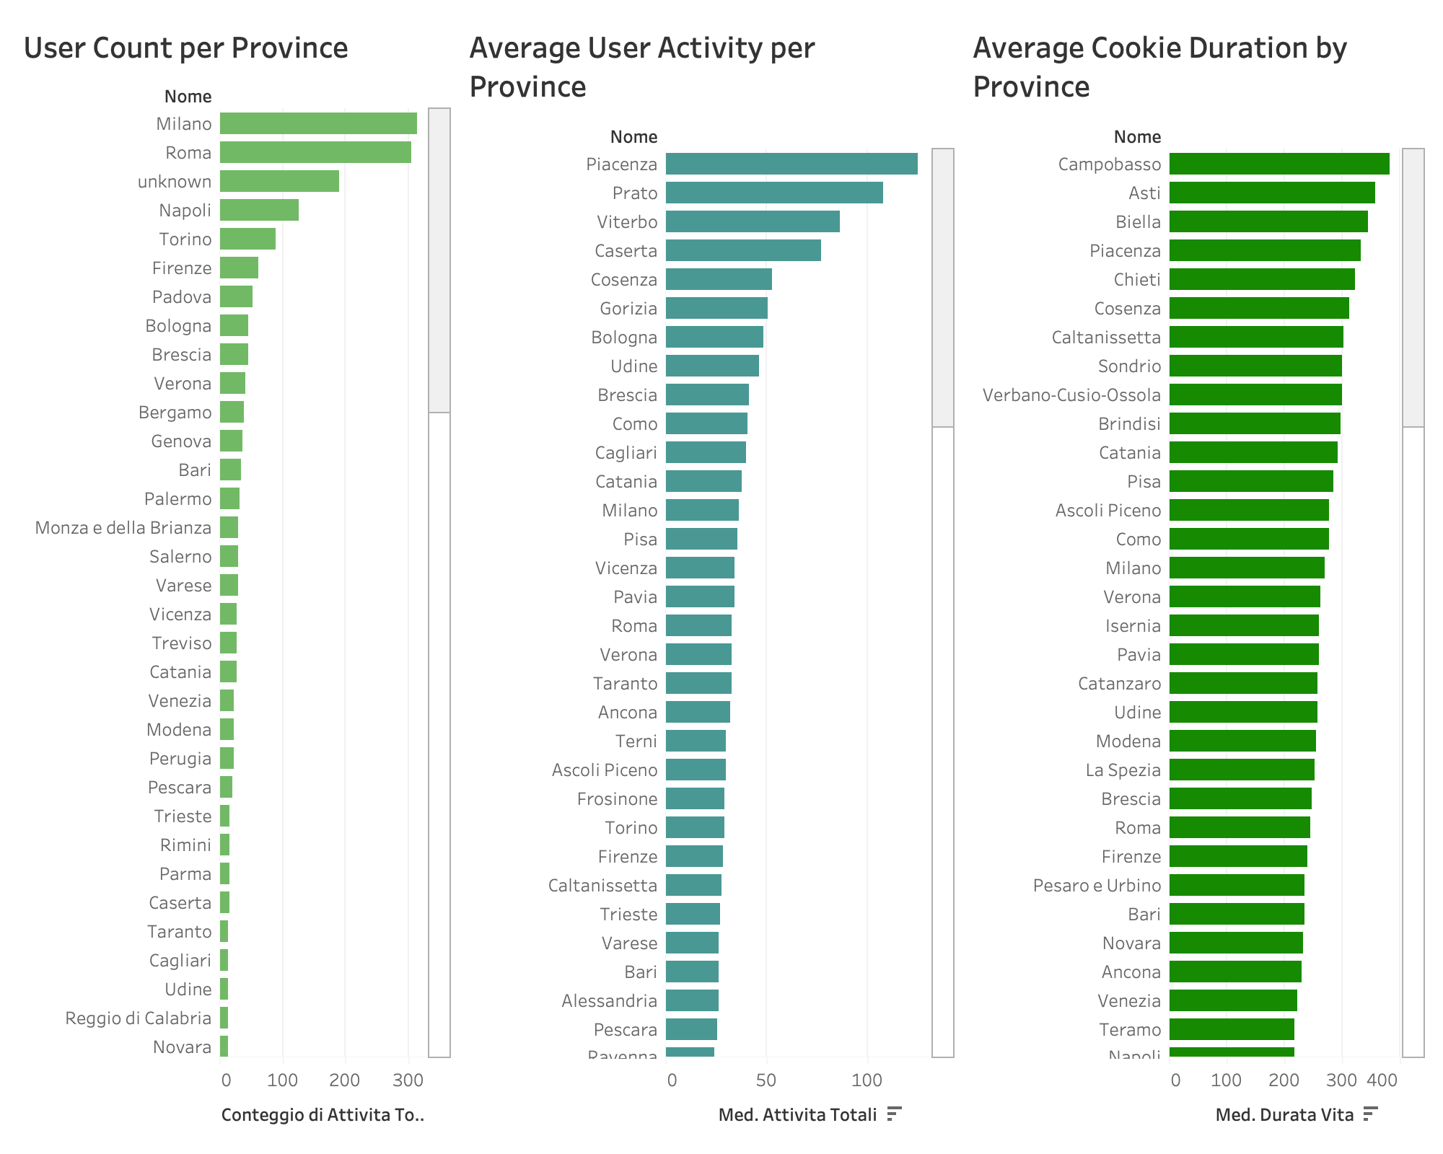
EDA- Province Engagement
Graphical Analysis:
User count by province;
Average activity per province
Average cookie duration by province

Slide 9
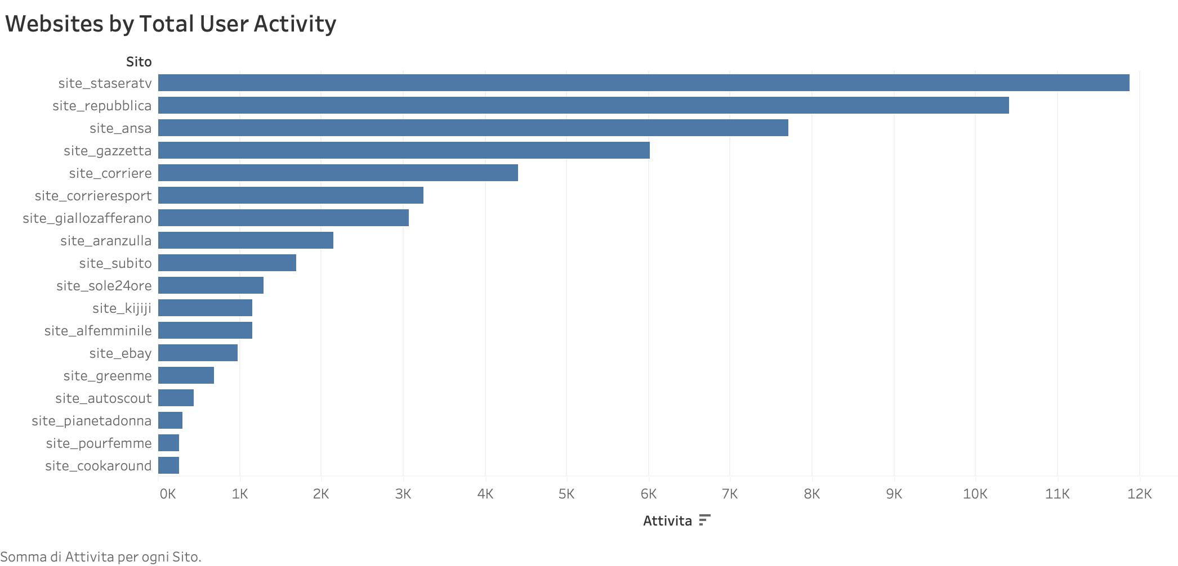
EDA-Website Popularity
Top visited websites ranking:
site_staseraTv + site_repubblica = >39% of visits
Followed by site_ansa and site_gazzetta
Other sites: low & decreasing engagement
News & entertainmen: most popular content

Slide 10
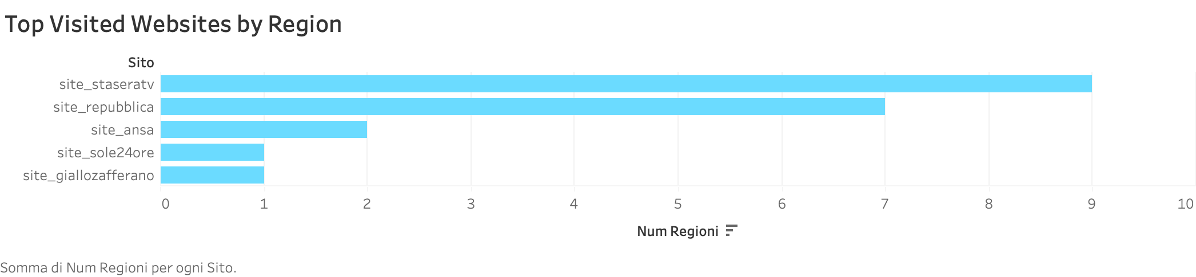
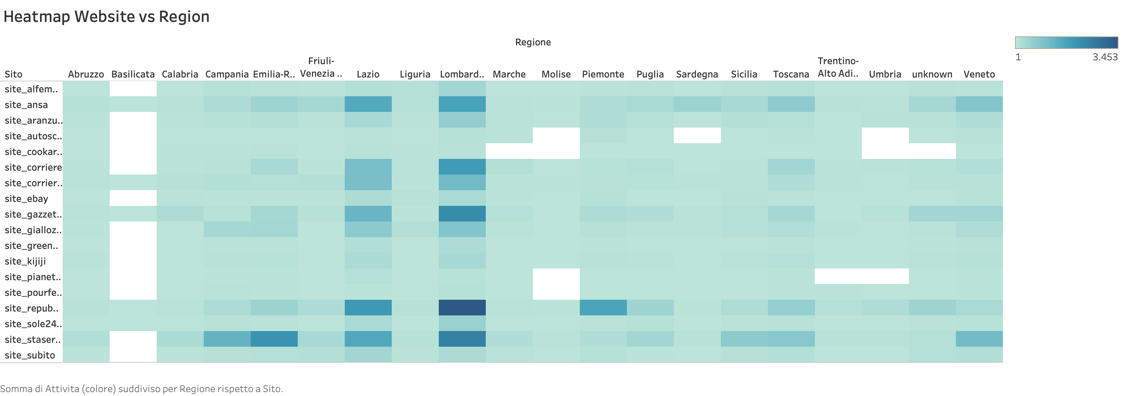
EDA-Website Popularity by Region
Regionally dominant websites:
site_staseratv, site_repubblica, and site_ansa show;
Strong presence in Lombardy, Lazio, and Campania.
Scattered usage:
Sites like site_giallozafferano and site_kijiji exhibit more localized or specialized activity patterns.

Slide 11
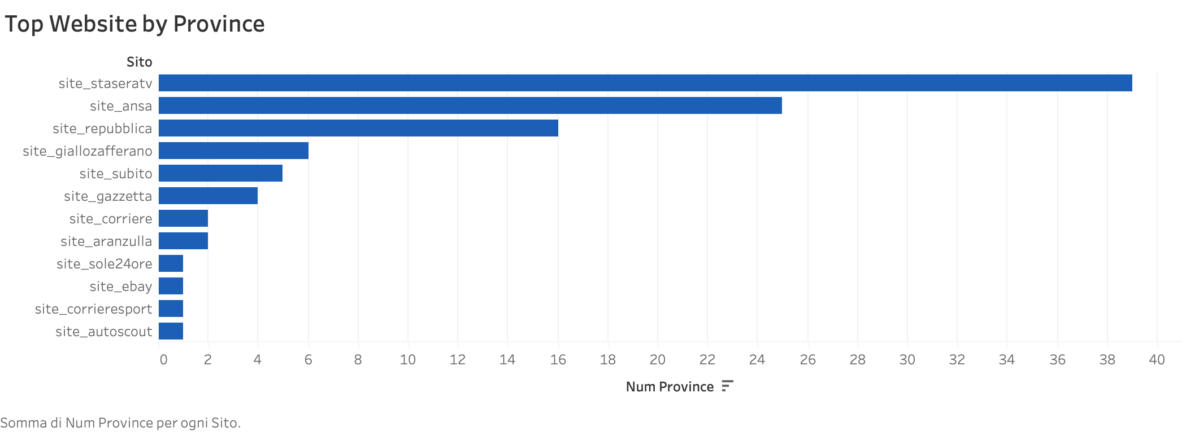
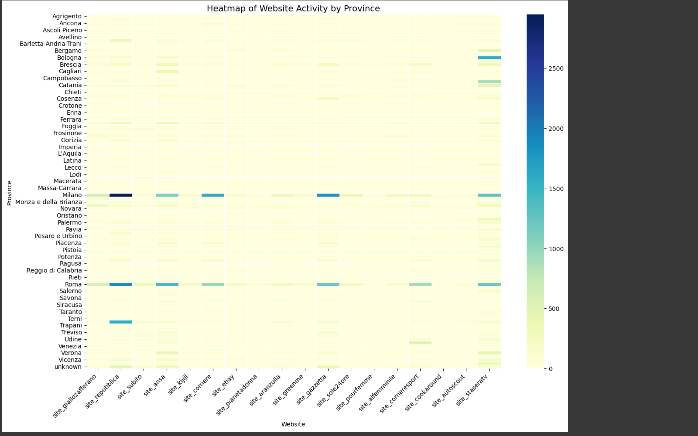
EDA-Website Popularity by Province
Bar chart insights:
site_staseraTV leads;
Followed by site_ansa and site_repubblica.
Other sites have limited regional reach.
Heatmap insights:
Clear spikes in activity in urban centers like Rome and Milan.
High engagement on site_staseraTV and site_repubblica.
Most provinces show limited activity, with concentration in a few major cities.

Slide 12
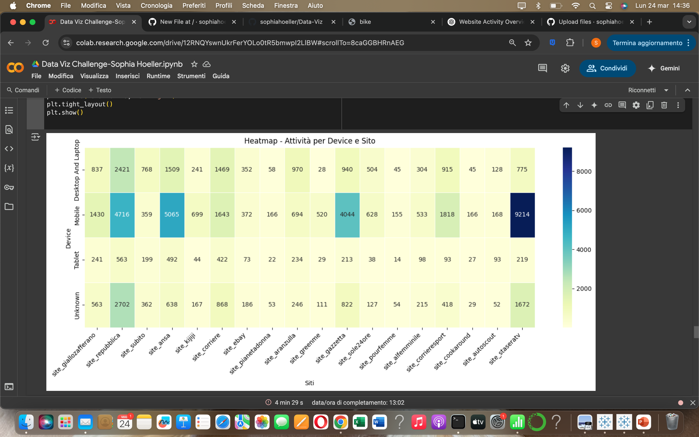
EDA-Top Visited Websites by Device Type
Key Features:
Mobile → dominant on most sites (staseraTV, ansa, gazzetta)
Desktop/Laptop → strong on repubblica
Tablet → low activity
Unknown → moderate traffic (repubblica, staseraTV)

Slide 13
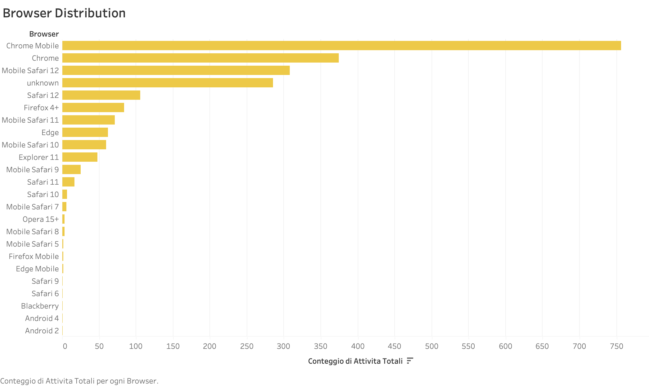
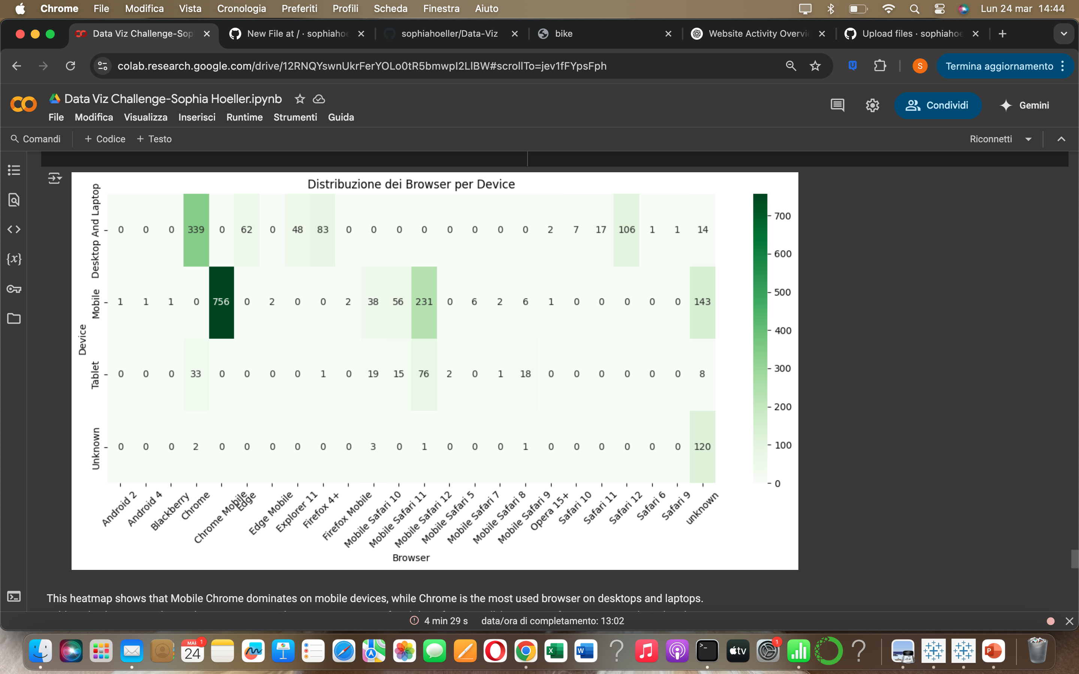
EDA-Browser Analysis
Key Findings:
Mobile Chrome → dominant on mobile devices
Chrome → most used on desktops/laptops
Mobile Safari → strong on tablets
Tablet usage → more browser diversity
Overall → browser choice closely linked to device type
Key point → Google’s browsers (Chrome + Mobile Chrome) lead across platforms

Slide 14
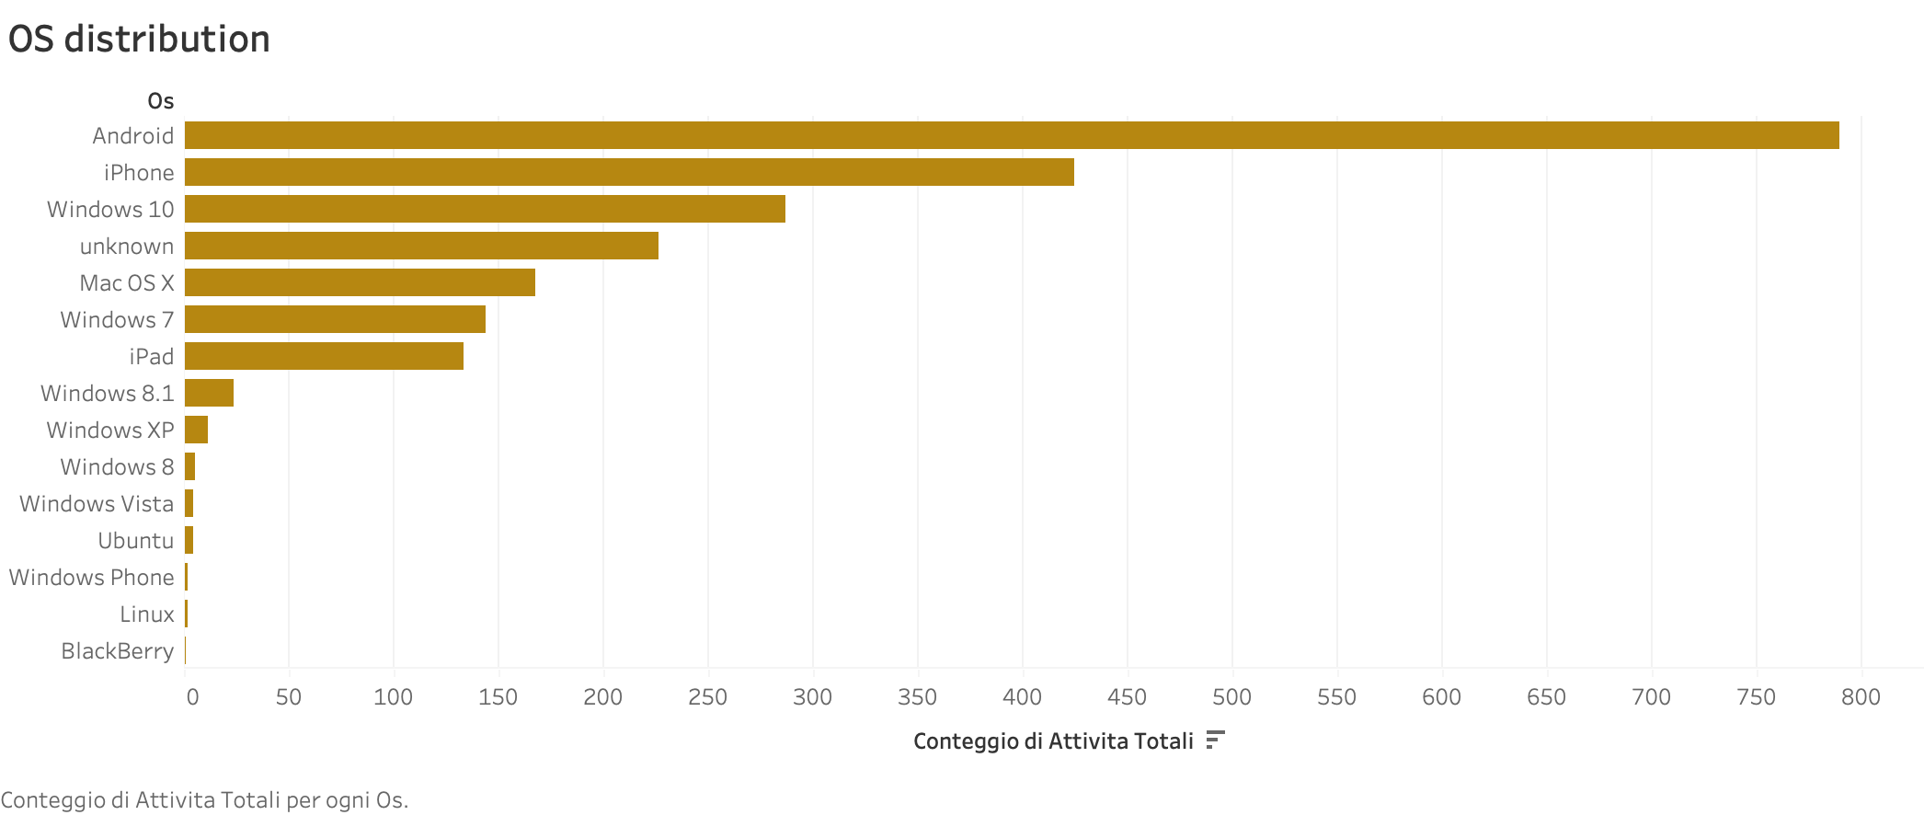
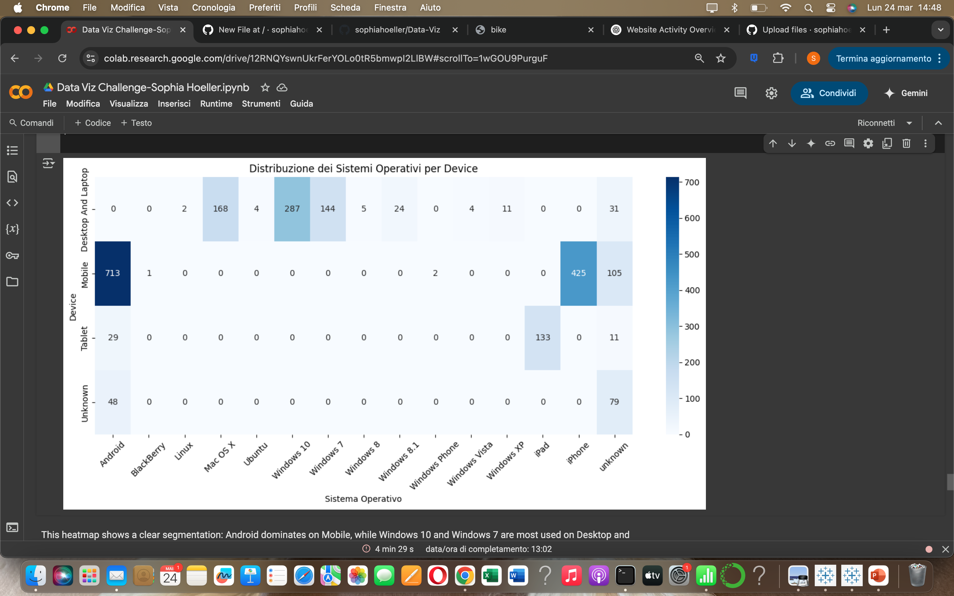
EDA-Operation Sistem Analysis
Key Features:
Android → dominant on mobile
Windows 10 & 7 → top on desktop/laptop
iOS (iPhone & iPad) → strong on mobile and tablet
Clear segmentation → minimal OS-device crossover
Overall → Android and iPhone lead by far
Desktop OS → Windows 10 and macOS follow
Minor share → older systems and Linux

Slide 15
Using Tableau for Enhanced Insights
Exported cleaned and enriched data from Google Colab
Saved datasets as .csv files for Tableau import
Imported cleaned dataset into Tableau Desktop
Built interactive dashboards for:
Website activity by region and province
Device, browser, and OS distribution
User engagement metrics
Enabled dynamic filtering by region, site, and device

Slide 16
CONCLUSIONS
KEY TAKEAWAYS:
Majority of users browse via mobile
News & entertainment sites are most visited
Strong regional differences in site usage
Chrome + Android define the tech landscape

Slide 17
THANK YOU

